Slide 1
Simple Linear Regression in R

Slide 2
What is Regression?
Allows you to predict y based on values of x
Both IV and DV can be continuous
The basic statistic behind modeling
+ simple = only one IV
+ linear = data forms a straight line

Slide 3
Code for Regression
modelName <- lm(DV ~ IV, data)
summary(modelName)

Slide 4
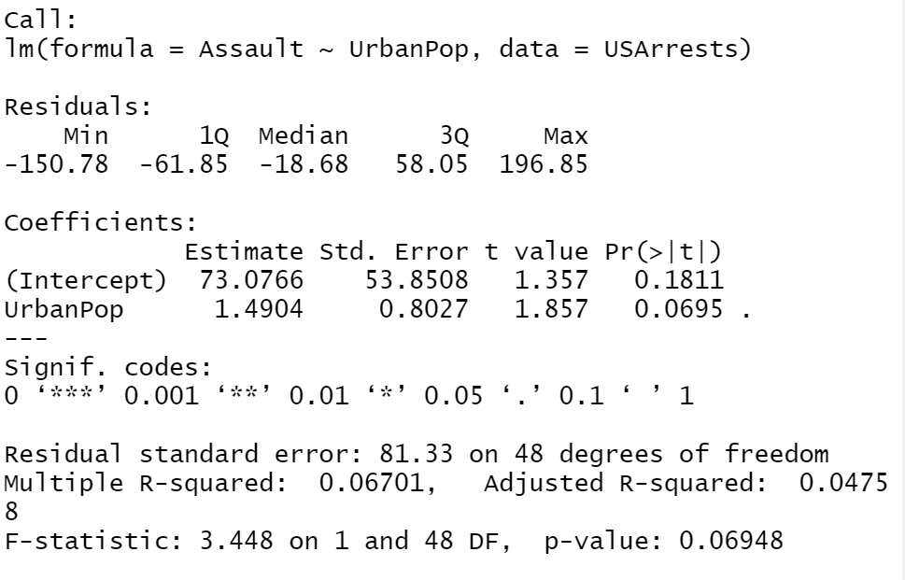
Interpreting Regression
Text
1. Overall model is significant if < .05

Slide 5
Interpreting Regression
Text
Amount of variability in the DV accounted for in the IV
Convert to a %

Slide 6
Interpreting Regression
Text
Variable is significant if < .05

Slide 7
Interpreting Regression
Text
A one-unit increase in this variable influences the DV by the estimate amount

Slide 8
Making a Scatter Plot with Best Fit Line
ggplot(data, aes(x=column, y=column))
+ geom_point()
+ geom_smooth(method=lm, se=FALSE)

